Slide 1
Substance Use Disorder (SUD) Loan Repayment Program (LRP) Next Steps 2022

Slide 2
Agenda
Applying for SAP Vendor Number
Filling out the Signature Page
Filling out the Grant Agreement
Filling out the W-9
Filling out Appendix A – Attachment 1
Once Complete / Invoicing Process

Slide 3
Applying for SAP Vendor Number
Steps
www.budget.pa.gov
Click on “For Vendors”
Click on the blue box “Vendor Registration”
Select “Non-Procurement”
Enter in social security number and press “Next”
Enter in legal name
This name should be yourself, the person creating the registration
Enter in your current legal name – if a loan is under a maiden name, enter in maiden name on second line, “(if different than Legal Name)”
Select “Sole Proprietor” under “Business Type”

Slide 4
Applying for SAP Vendor Number
8. Enter in E-mail address, telephone number, and full home address
Please use the zip +4, if possible
If you choose to use a PO box, do not enter anything in “street address”
9. Read and select “Yes” under the Data Privacy Statement
10. Press “Next”
11. The system will take the information filled out and will create an electronically signed W-9 which is needed for IRS purposes
**These instructions can also be found in the SUD Loan Repayment Program tab titled “Non-Procurement Registration Guide”. This tab is located under the “Funding” on the DDAP website.

Slide 5
SAP Vendor Number Next Steps
Once the online form is processed, you will receive your SAP vendor # via email from Vendor Management
Please send an email with your name and SAP Vendor # to RA-DAGRANTSMGMT@pa.gov
In the email from Vendor Management, you will be asked to provide banking information for electronic transfer
This is necessary to receive funds under the SUD LRP
Once complete, you will receive a “bank partner code”. When this step is complete. Please send an email with your name and this code to RA-DAGRANTSMGMT@pa.gov

Slide 6
Things to Keep in Mind
Vendors registered under Non-Procurement cannot self-certify or place bids
The registration can take 3-5 business days to process
Your vendor registration number should not start with the numbers 1, 2, 3, 4 or 5. If this occurs, please reach out to DDAP via email at RA-DAGRANTSMGMT@pa.gov

Slide 7
Signature Page (Page 1) of Grant Agreement
Using the Fill and Sign option:
Enter legal name on first line and current mailing address on second line
Sign, date, type discipline (title), and type legal name
Do not enter any numbers next to “SAP#” at the top of Signature Page
Only one signature is needed, please disregard all other signature lines

Slide 8
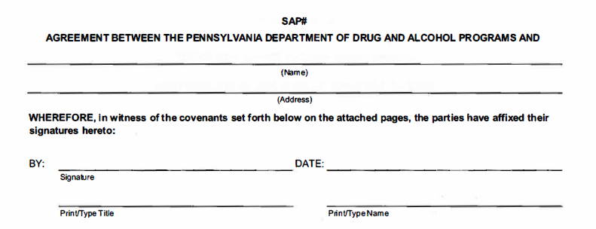
Signature Page (page 1) of Grant Agreement

Slide 9
Grant Agreement
Using the Fill and Sign option:
Do not fill out the SAP # section.
Type legal name on first line below “Grant Agreement Between the Pennsylvania Department of Drug and Alcohol Programs AND”
Type legal name in first paragraph “and _____ hereinafter referred to as “grantee”
Please ensure legal name and mailing address is capitalized and spelled correctly
Notes:
- Maiden name??

Slide 10
Grant Agreement

Slide 11
Grant Agreement
Using the Fill & Sign option:
In Section III “Grant Agreement Amount” of the Grant Agreement, enter the total Grant Agreement dollar amount as it appears in the Award Letter

Slide 12
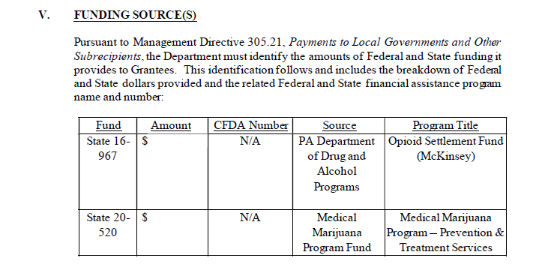
Grant Agreement
Using the Fill & Sign option:
In Section V “Funding Source(s)” of the Grant Agreement, enter the two equal payment amounts (one in each amount box) which equals Award Letter amount. The total of amount below should be equal to Award Letter.

Slide 13
W-9
Complete the separate W-9 form per directions on the documents
Section 1: Name as shown on your income tax return.
Section 3: Check off “Individual/Sole Proprietor”
Section 5 and 6: Home address as entered on application.
Part 1: Enter social security number.
Part 2: Signature and date.

Slide 14
Appendix A – Attachment 1
Using the Fill & Sign option:
Section A: Grantee
Type in Legal Name, Discipline, License Number (if applicable), Address, Phone #, and Email Address
Section B: Approved Practice Site
Type in Name of Practice Site, Phone # of Practice Site, and Address of Practice Site.
Repeat for Site 2 if applicable

Slide 15
Appendix A – Attachment 1
Section E: Lending Institution(s)
Type in Name of Lending Institution, Address of Lending Institution, Lender Payment Address, Account #, and Amount owed
Repeat for second Lending Institution if applicable
Section F: Loan Balance
Enter total loan balance
Section G: Total Potential Loan Repayment Grant Funds:
Enter Grant Agreement dollar amount as written on Award Letter

Slide 16
Once Complete / Invoicing Process
Send all completed documents; Signature Page and Grant Agreement, W9, and Appendix A – Attachment 1; as three separate PDFs to RA-DAGRANTSMGMT@pa.gov
Invoicing will occur in two separate payments
The first will occur after the Grant Agreement is fully executed
The second will occur in the summer of 2023

